Slide 1

AI in Stock Price Prediction
CASE STUDIES IN DATA ANALYTICS & AI
PRABANCHAN CV (U2058657)

Slide 2
Content
Introduction
Dataset
Experimental Setup
Experimental Work
Experimental Results
Performance Evaluation
Conclusion

Slide 3
Introduction
Stock markets are where individual and institutional investors come together to buy and sell shares in a public venue.
The stock market is extremely volatile; any geopolitical change can have a significant impact on stock prices, as we recently saw with Covid-19, which is why performing a reliable trend analysis on financial data is extremely difficult.
AI provides efficient solution to deal with this cumbersome task with the help of machine learning techniques.
LSTM model with SGD & ADAM optimizers were used in this study.

Slide 4
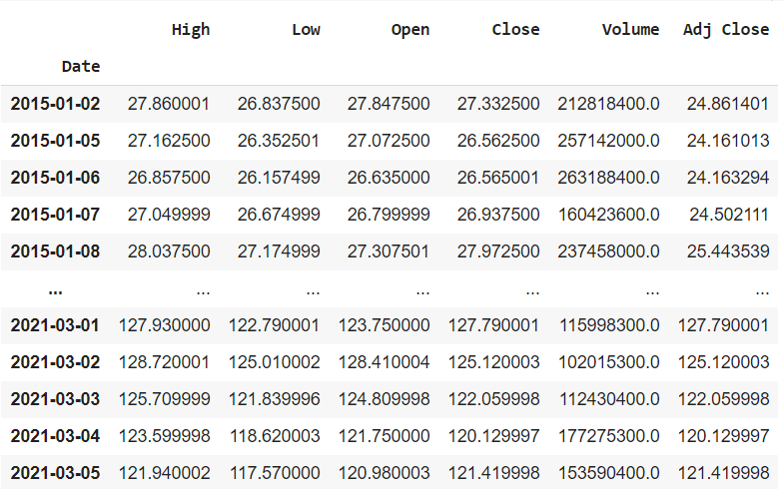
Dataset
VARIABLES DESCRIPTION
High, Low: It describes the maximum and minimum price of the share for the day.
Open, Close: It is the opening and closing price at which the stock is traded on a particular day.
Close is the chosen target variable, since the selling price of a stock for the day is normally used to calculate profit or loss.

Slide 5
Experimental Setup
IDE
Google colab
Language
Python
Libraries
Pandas (DataReader for importing live stock data from the source (YAHOO)
Numpy
Matplotlib
Seaborn
Sklearn metrics (Sklearn preprocessing for MinMax scaling)
Keras (Sequential, Dense, LSTM for developing LSTM model)

Slide 6
Experimental Work
Data Pre-processing
Feature Scaling using MinMax scaler.
Data Partition
Train, test for training and testing the LSTM model.

Slide 7

Experimental Work (cont)
LSTM model
Variant of RNN that introduce a number of special, internal gates.
Internal gates help with the problem of learning relationships between long and short sequences in data
Pro: Introduces many more internal parameters which must be learned. It is flexible.
Con: Introduces many more internal parameters which must be learned. It is time consuming.
LSTM Architecture

Slide 8
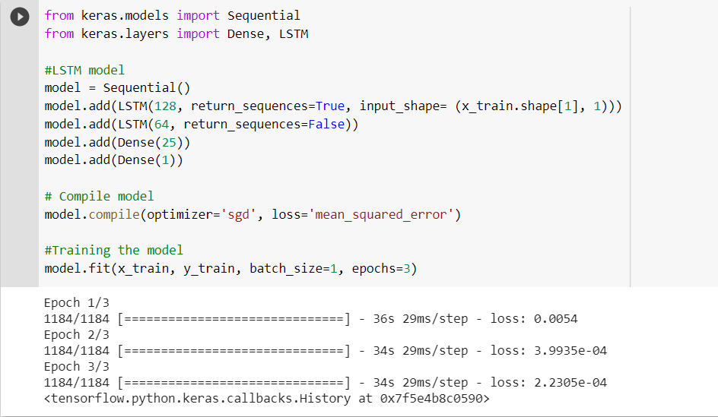
Experimental Work (cont)
LSTM model

Slide 9
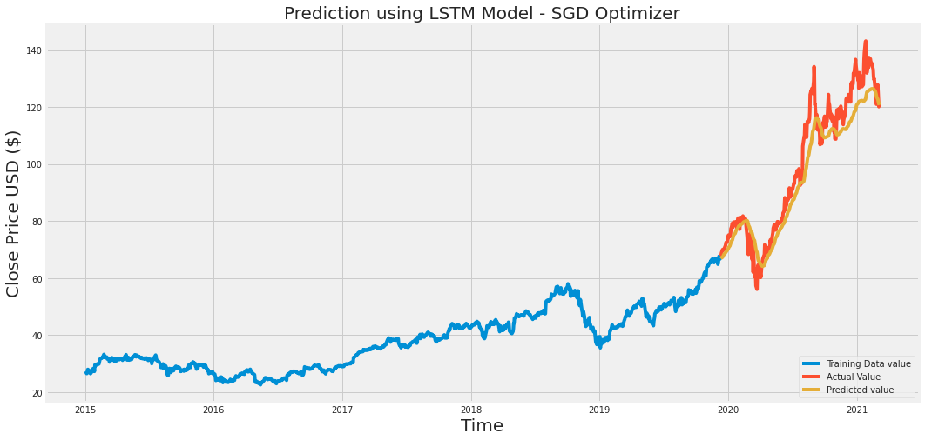
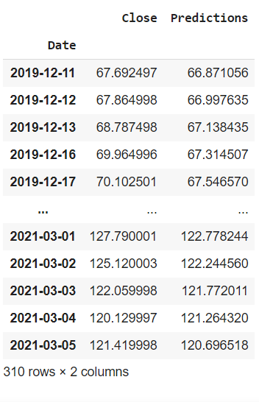
Experimental Results
Prediction using LSTM model – SGD optimizer

Slide 10
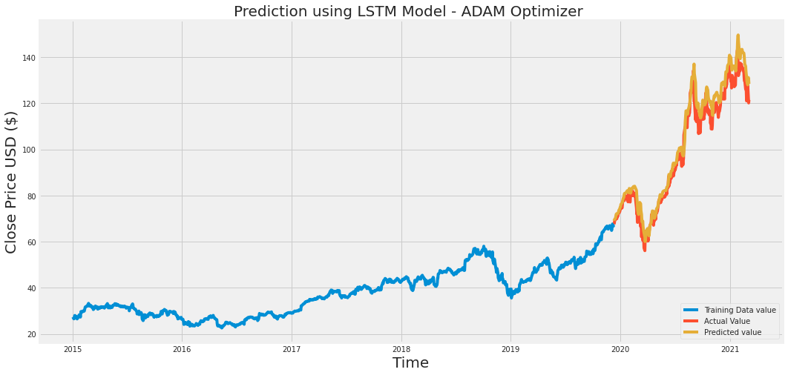
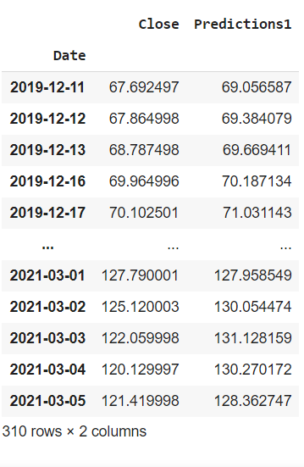
Experimental Results (cont)
Prediction using LSTM model – ADAM optimizer

Slide 11
Performance Evaluation
LSTM model performance was evaluated using Root Mean Squared Error (RMSE) & Mean Absolute Error (MAE)
 | RMSE | MAE
SGD optimizer | 7.54 | 6.05
ADAM optimizer | 4.92 | 3.90

Slide 12
Conclusion & Future Work
Predicted stock price of a Apple Inc using LSTM model.
LSTM model using both optimizers performed well.
Predicted closing value of stock price with low RMSE & MAE.
To obtain more useful prediction on stock market, sentiment analysis on financial news, public opinion on social media could be used.

